Slide 1
PROXY SERVER
WEB CACHING

Slide 2
Project Background
Consider a person is requesting a URL to frequently such as the Home Page of Browser, so this request made again and again which add traffic to the network.
Everytime a DNS Server is required to resolve the URL to Server IP Address
Then Server is requested to send HTML Data
This is to time taking and traffic to network

Slide 3
What is Proxy Server?
A proxy server is a dedicated computer or a software system running on a computer that acts as an intermediary between an endpoint device, such as a computer, and another server from which a user or client is requesting a service. The proxy server may exist in the same machine as a firewall server or it may be on a separate server, which forwards requests through the firewall.
Proxy servers have two main purposes: to improve performance and to filter requests.

Slide 4
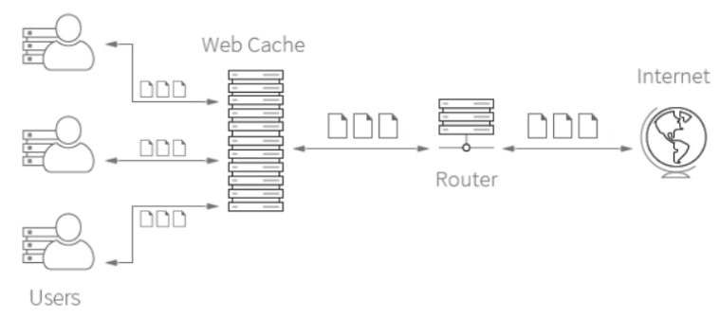
What is Web Cache?
A Web proxy cache is a type of cache that stores and delivers frequently accessed websites, images and/or objects on the Internet. It is designed to help in delivering Internet-based data and objects more quickly to end users and also to free up bandwidth.

Slide 5
Web Cache Strategies
FIFO
LIFO
LRU
MRU
Random

Slide 6
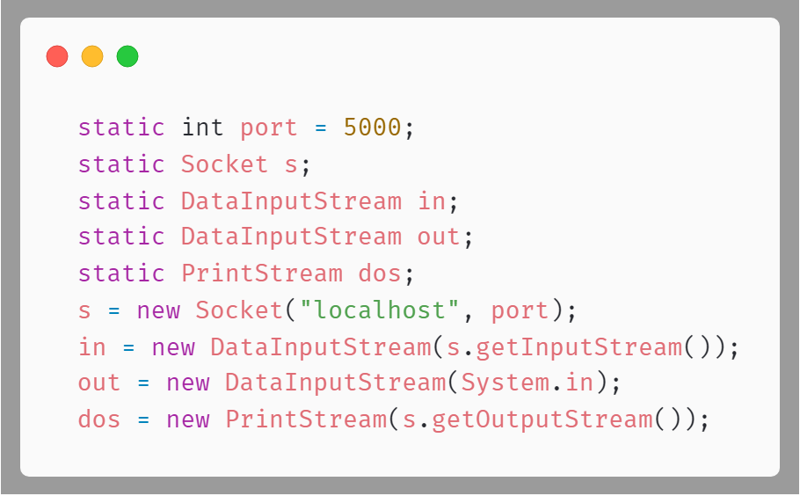
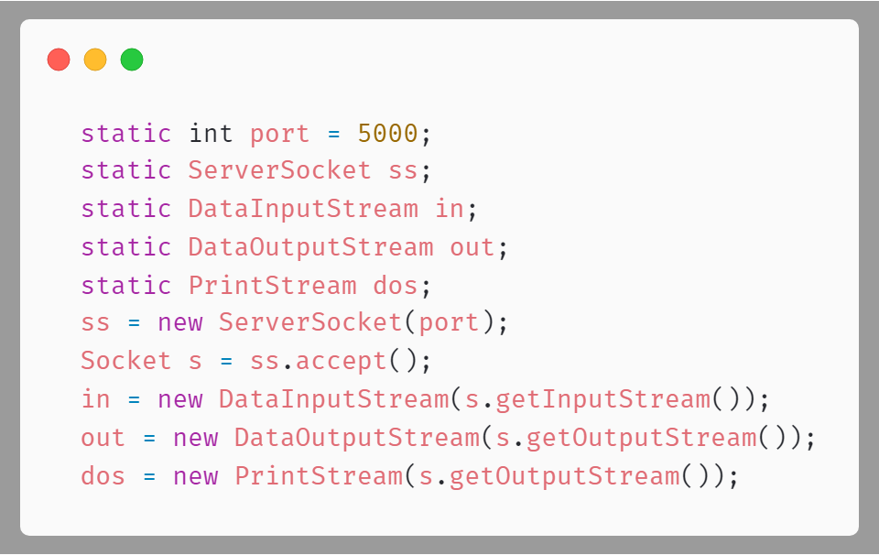
Project Methodology
Client End
Server End

Slide 7
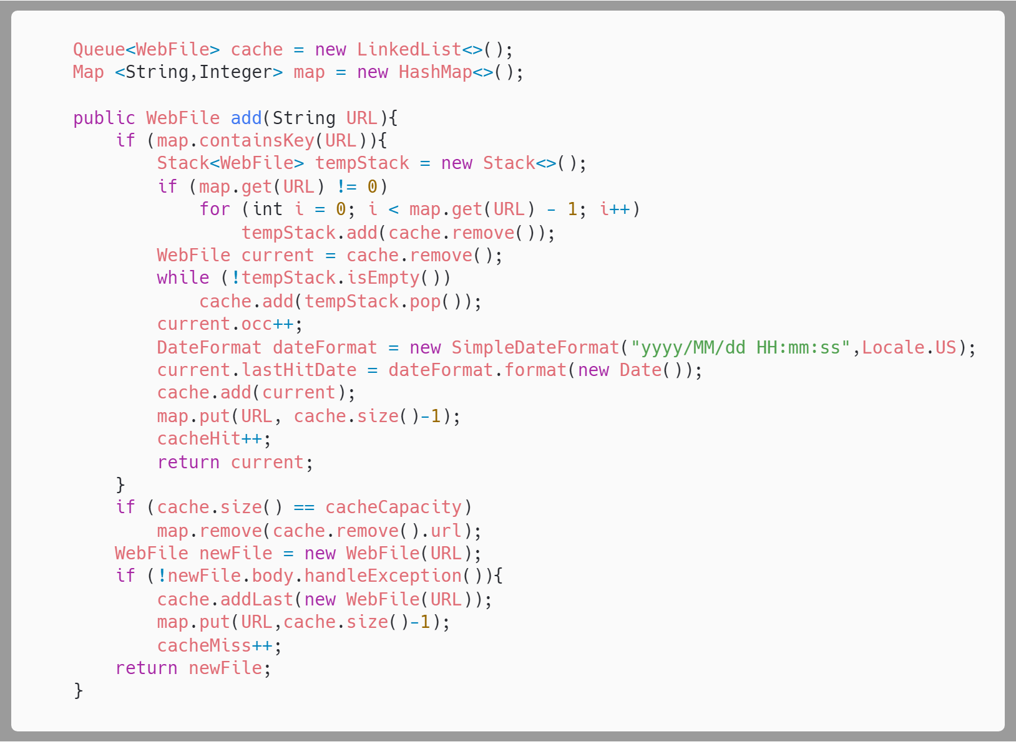
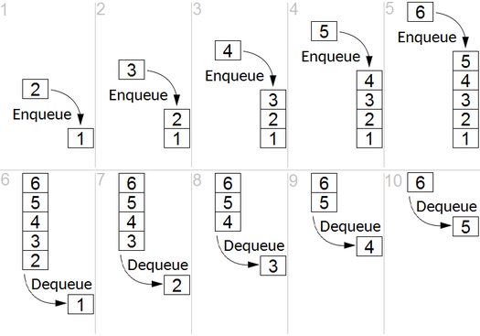
FIFO - First In First Out

Slide 8
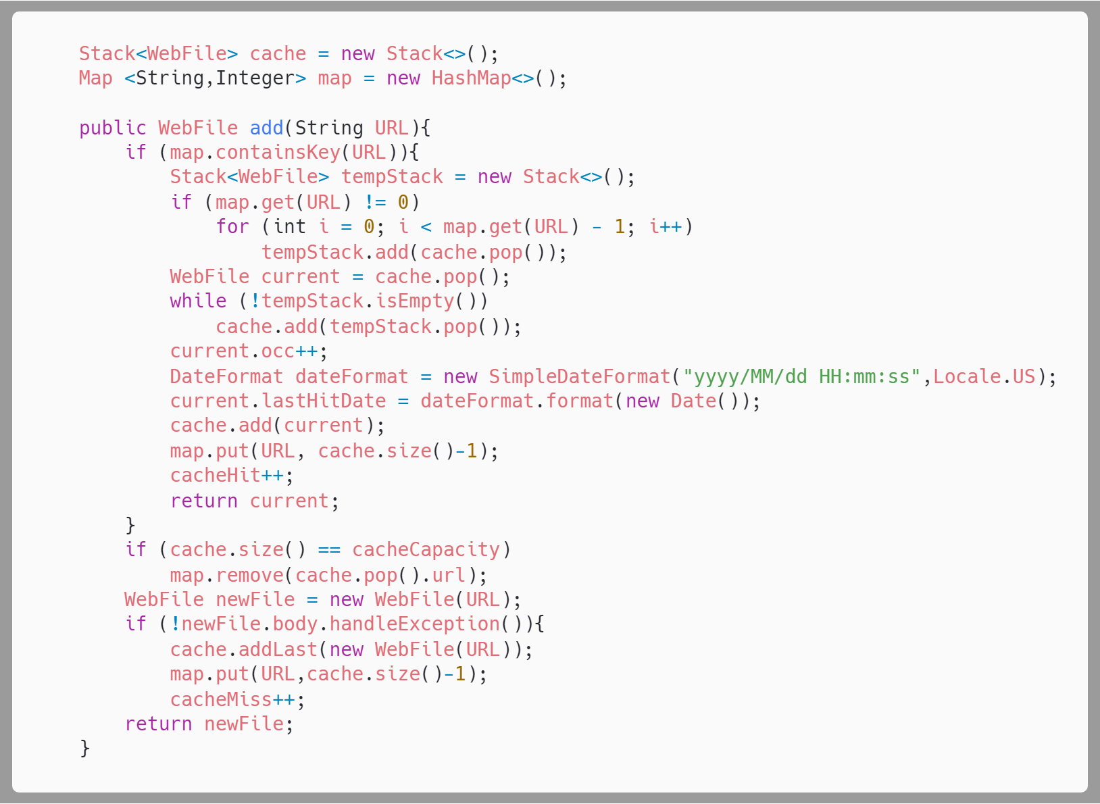
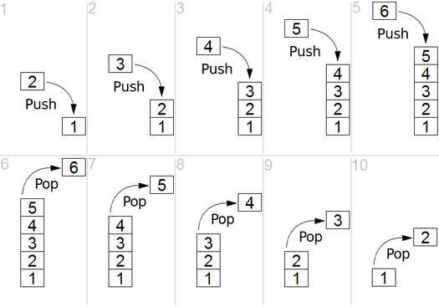
LIFO - Last In First Out

Slide 9
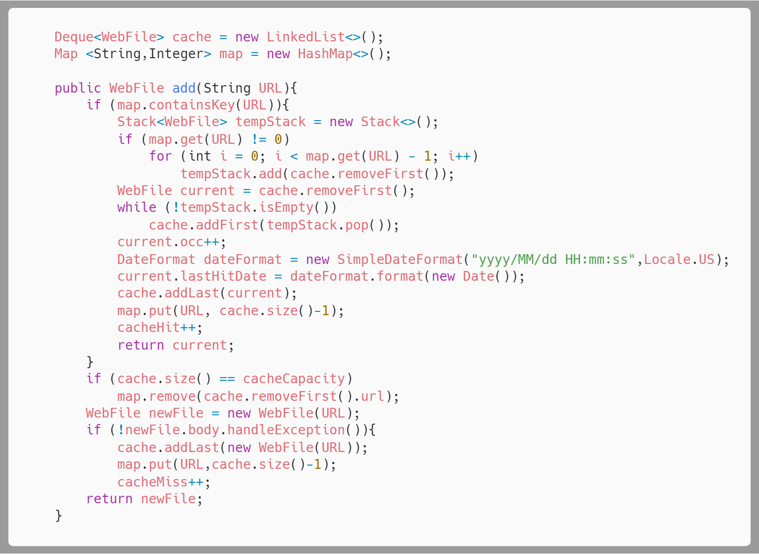
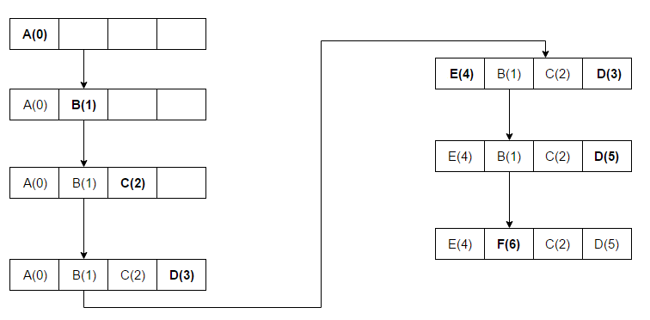
LRU - Least Recently Used

Slide 10
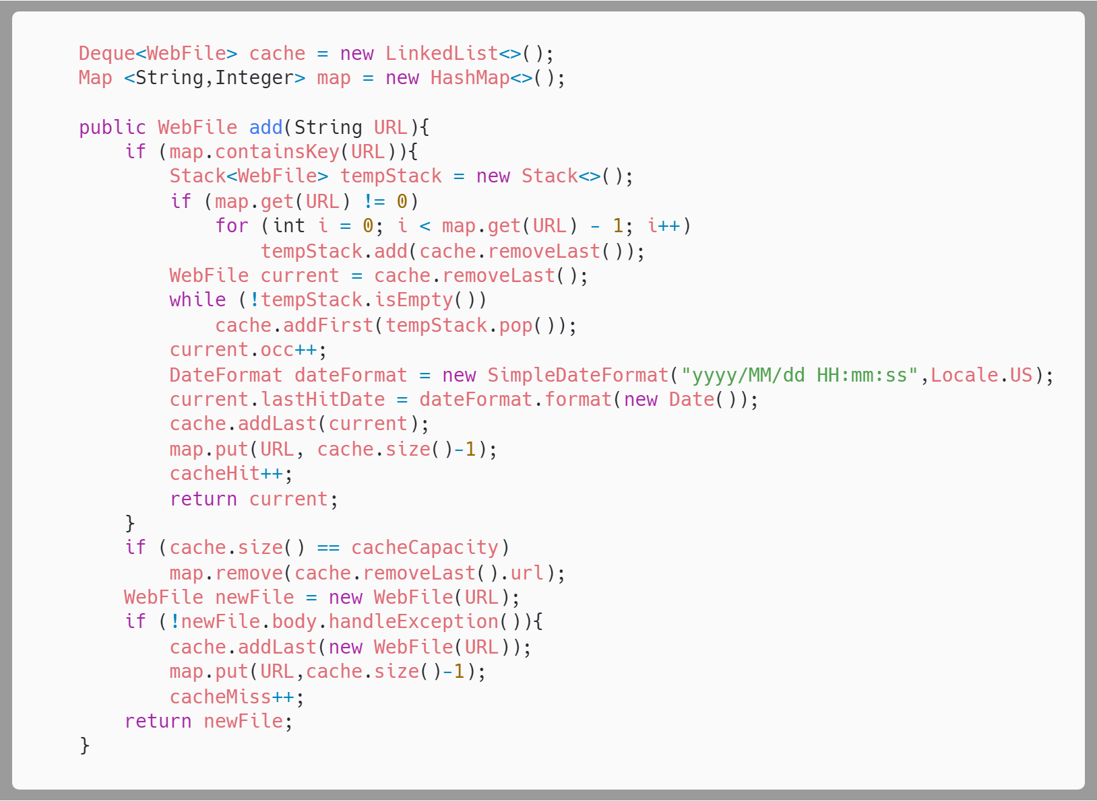
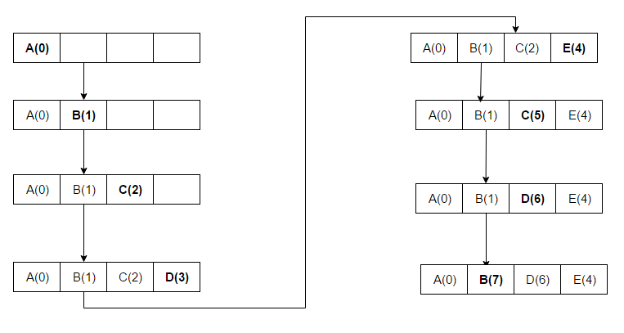
MRU - Most Recently Used

Slide 11
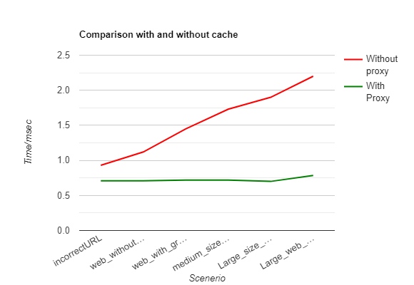
Fetching Web File With and Without Cache

Slide 12
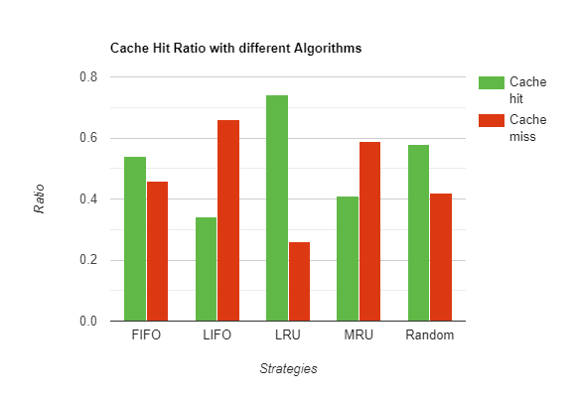
Cache Hit Rates of Different Strategies

Slide 13
Future Work
More Strategies:
multi-level cache which can significantly affect the retrieval rate
learning the trend of the user and predict the users request so we can remove other than that particular response
Benefits that will be achieved:
will increase the cache hit and reduces miss hits
significantly affect the retrieval rate
Less network traffic

Slide 14
Acknowledgement
Group Members
Mehdi Raza Rajani - 16k-3904
Moazzam Maqsood - 16k-3868
We first studied the research paper “Design and Implementation of Server Side Web Proxy Caching Algorithm” by Dr.K.Ramu and Dr.R.Sugumar and then implemented the concept.

